Slide 1

SparQL
Querying semantic data

Slide 2

Introduction
Overview of the Semantic Web
How interrelated datasets (linked data) work
Triples vs relations (tables)
Semantic Web Standards
RDF, OWL etc.
SPARQL Syntax
SELECT, WHERE, LIMIT, variables, etc.
Shortcuts, graphs, and unions
Querying a Semantic Website
Accessing a SPARQL Endpoint
Querying a dataset
Advanced SPARQL Constructs
FILTER, OPTIONAL, etc.
Modelling Semantic Data
URI, URL, URN, Namespace, etc.
Semantic Web standards (RDF, OWL, etc.)
Integrating SPARQL into an Application
Java libraries (Jena, etc.)
Transitioning a Website into a Semantic Web Website
Converting data into semantic data
Troubleshooting
Summary and Conclusion
Ajay Singhal : Skype: aksing1711

Slide 3
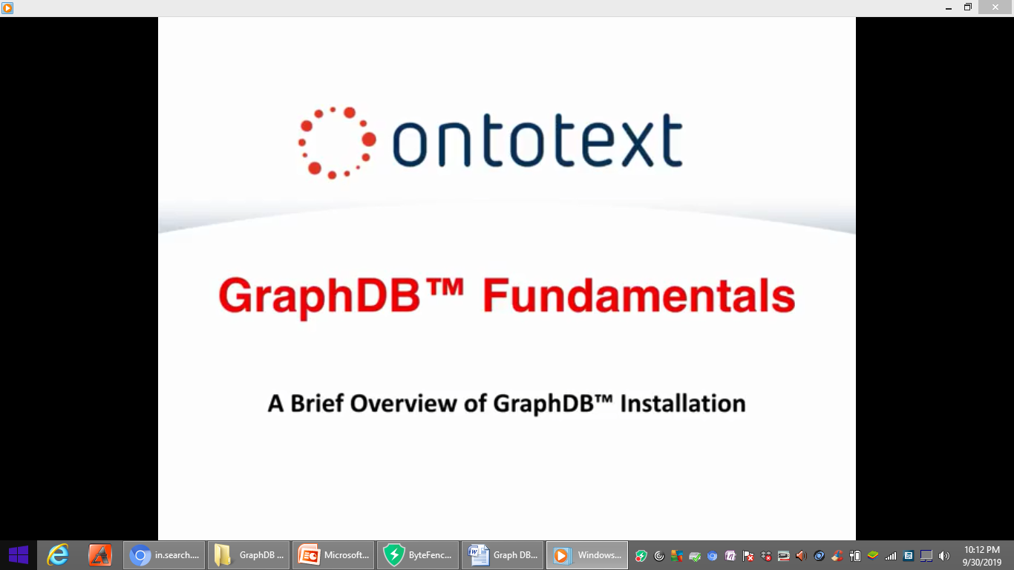
Notes:
Welcome to Ontotext graph DB
fundamentals training class in this
video we will give a brief overview of
graph DB installation let's get started

Slide 4
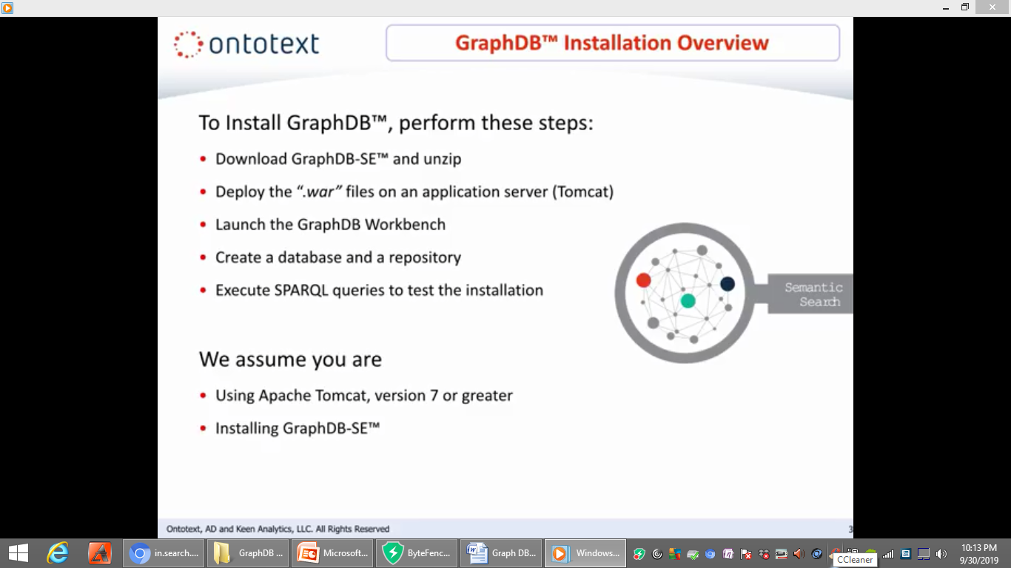
GraphDB INSTALLATION OVERVIEW
Notes:
The installation process for graph DB
consists of five basic steps first you
need to download graph DB SE and unzip
the downloaded file next you will need
to deploy the war files on an
application server third you will launch
the graph DB workbench fourth you will
need to create a database and a
repository finally you will want to
execute Sparkle queries to test your
installation this installation process
assumes you have Apache Tomcat version 7
or greater on your system and that
you're installing graph DB se

Slide 5
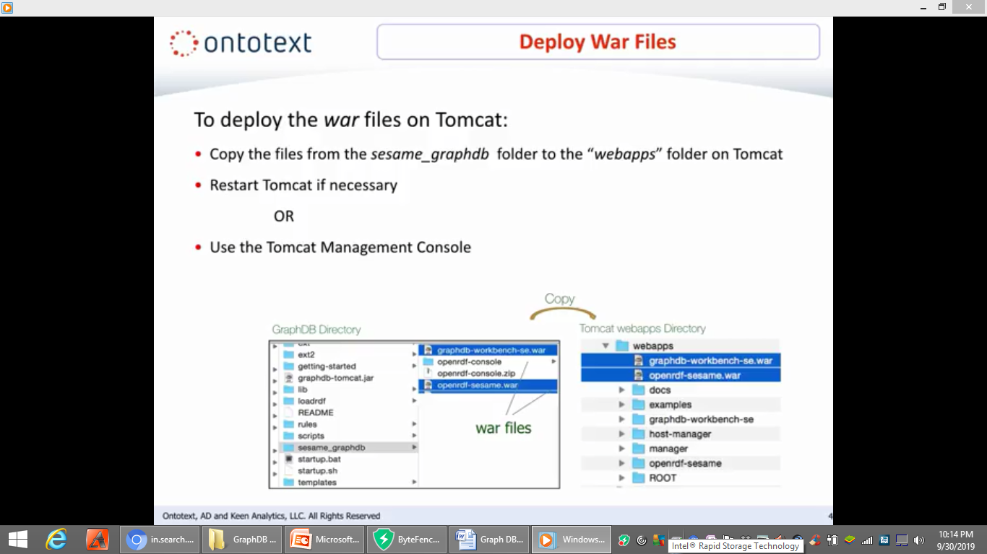
DEPLOY WAR FILES
Notes:
Let's
assume you have completed step one which
involves downloading graph DB and
unzipping the downloaded file now for
step two you need to deploy the war
files on Tomcat to deploy the war files
on Tomcat simply copy the files from the
sesame graph DB folder to the web apps
folder on Tomcat as you can see below we
have highlighted the war files in blue
after copying the files you may need to
restart Tomcat as an alternative you may
choose to deploy the war files using the
Tomcat management console which we
demonstrate on the next slide

Slide 6
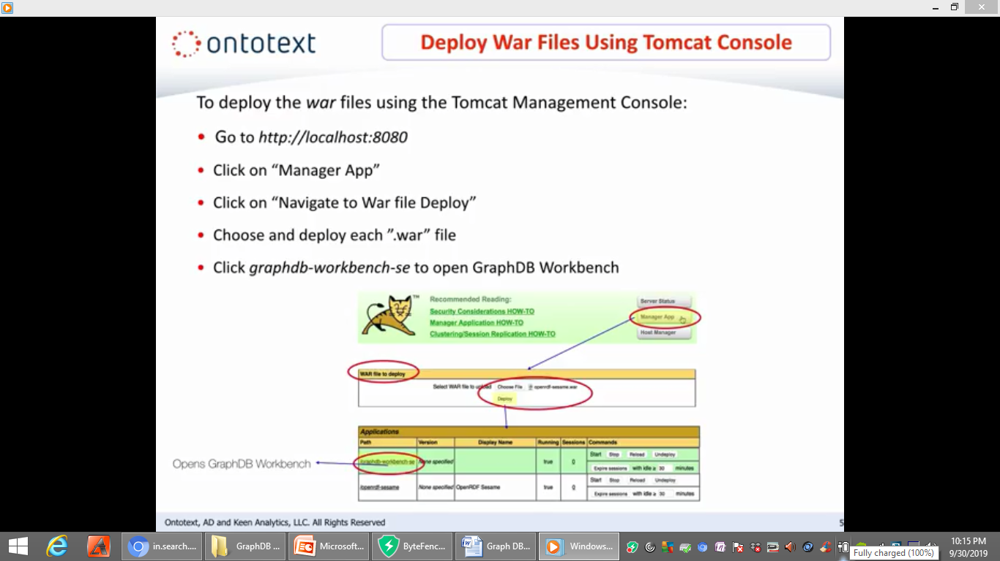
DEPLOY WAR FILES USING TOMCAT CONSOLE
Notes:
It's
convenient and easy to deploy the war
files directly from Tomcat using the
Tomcat management console
simply go to http localhost:8080 click
manage your app then for each of the war
files click on navigate to war file
deploy choose and deploy the war files
after you have finished deploying the
war files click graph DB workbench se to
open graph DB workbench

Slide 7
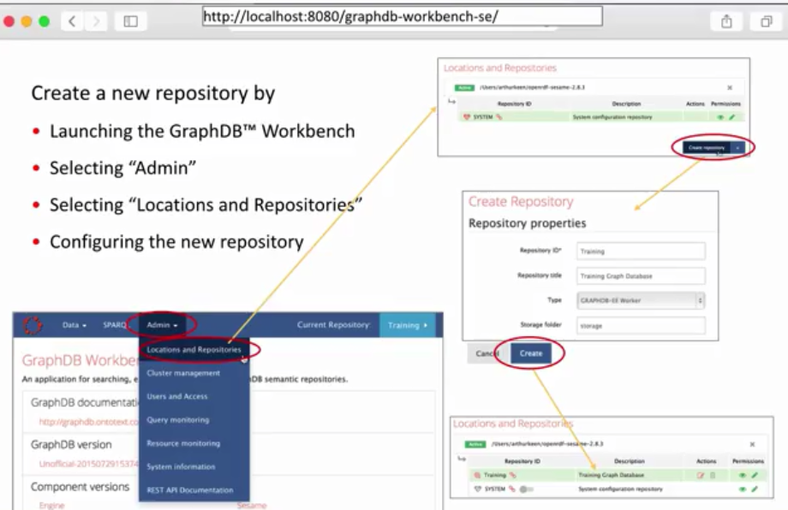
GraphDB WORKBENCH NEW REPOSITORY
Notes:
For the next
step in the installation process we want
to create a new repository on the
previous slide we launch the graph DB
workbench once the application is open
we select admin from the tabs at the top
of the screen next we select or click
locations and repositories then we
configure the new repository selecting
create repository filling in the needed
repository information and finally
clicking create our repository is now
created

Slide 8
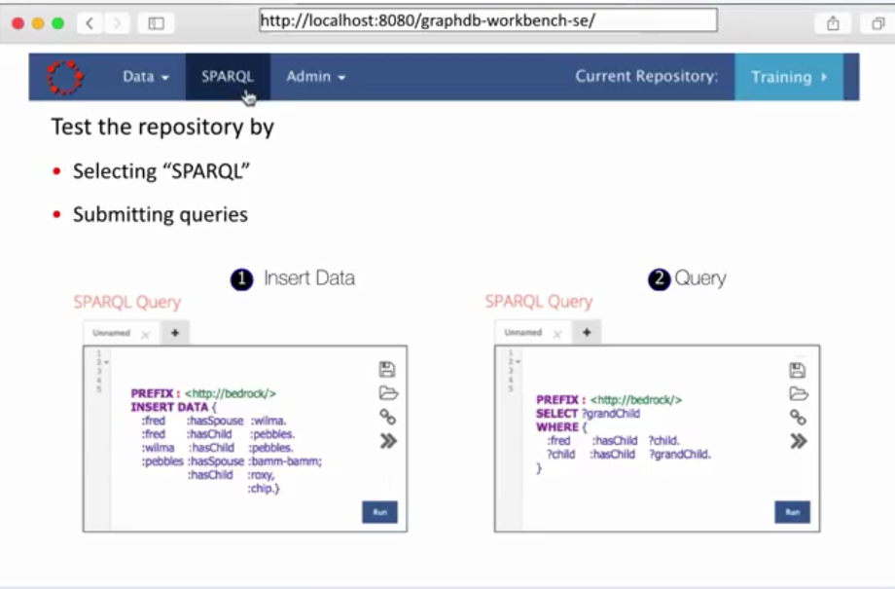
GraphDB WORKBENCH EXECUTE QUERIES
Notes:
Finally for the last step we
want to test the repository to perform
the test we first select sparkle shown
at the top of the screen next we write
and execute Sparkle queries in our
examples shown on the bottom left we
wrote a query to insert data about the
Flintstones and we also want to test the
repository by writing a query that
selects information an example is shown
on the bottom right where we write a
query to
list Fred Flintstone's grandchildren
when our executed queries returned the
expected correct results we know our
graph DB installation is successful

Slide 9
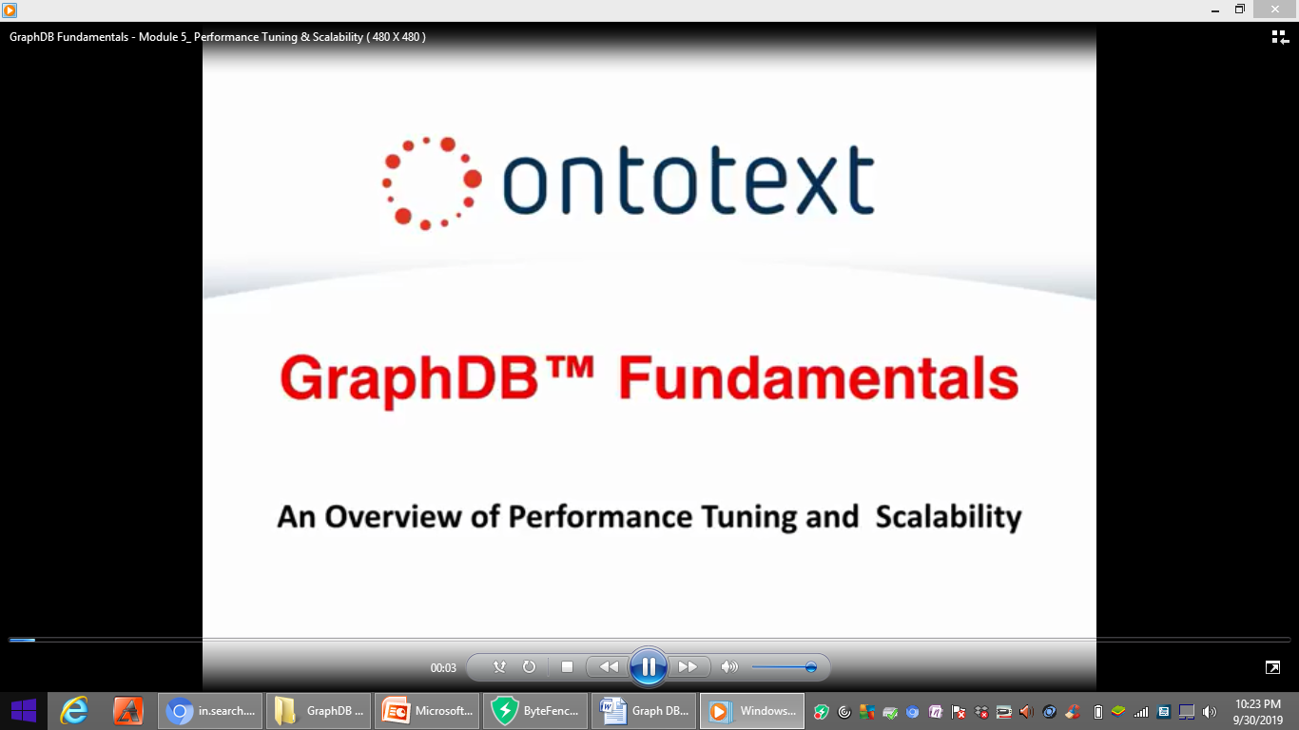

Slide 10
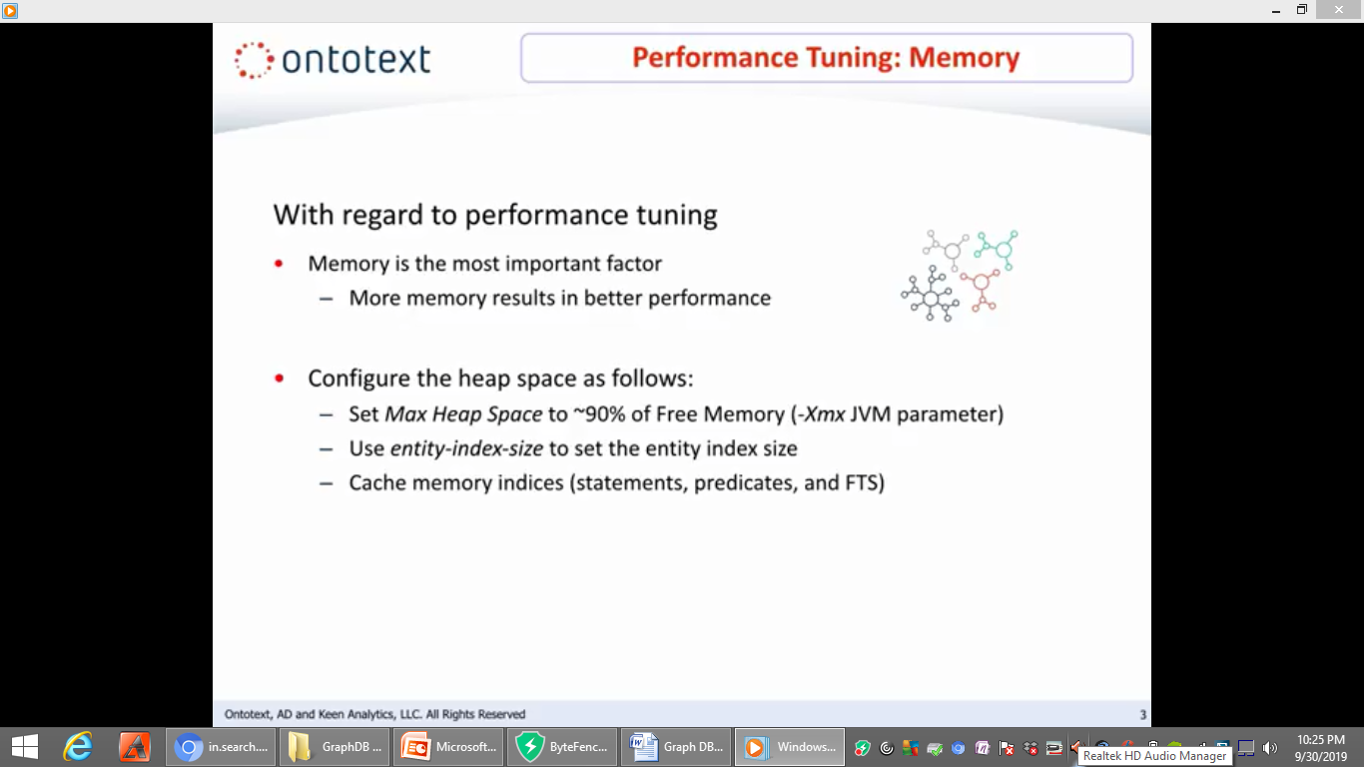
PERFORMANCE TUNING: MEMORY
Notes:
First we'll begin with
performance tuning memory is the most
important factor for performance tuning
the more memory the better the
performance you will want to configure
the max heap space to be around 90% a
free memory heap space is allocated to
different data structures the entity
index size can be set using entity index
size cache memory is consumed by
statement predicate and FTS indices

Slide 11
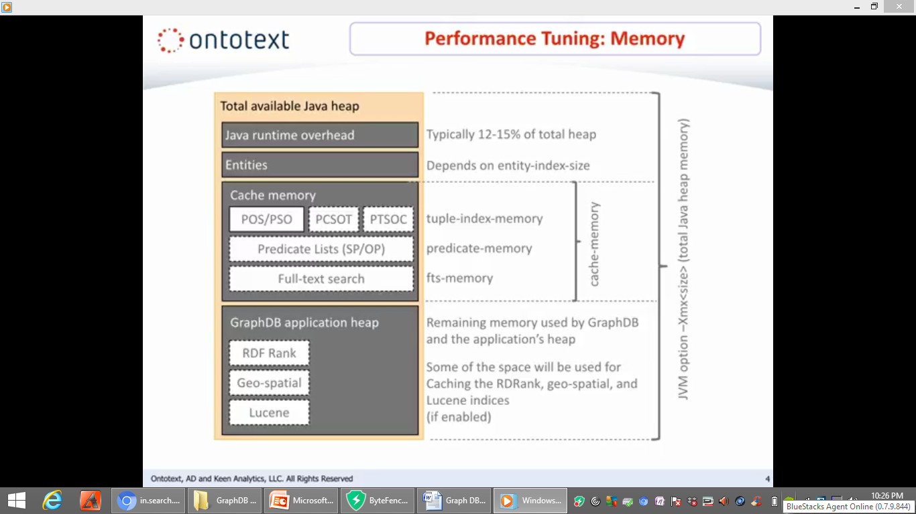
PERFORMANCE TUNING: MEMORY
Notes:
Here
are a few more details of memory usage
Java runtime overhead is typically 12 to
15 % of total heap space allocated for
entities depends on the entity index
size cache memory is used by statement
predicate and FTS predicates
specifically cache memory consists of
tuple index memory predicate memory and
full-text search memory tuple index
memory consists of predicate objects
subject and predicate subject object
indices and optional predicate contacts
subject object triple set and predicate
triple set subject object context
indices predicate memory includes the
predicate list subject predicate and
object predicate indices FTS memory is
full text search memory the remaining
memory is used by graft
and the applications heap some of the
space will be used by RDrank if
enabled geospatial if enabled in lucene if enabled

Slide 12
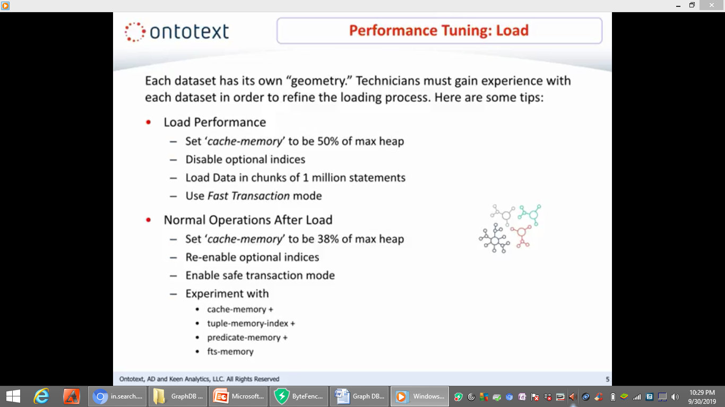
PERFORMANCE TUNING: LOAD
Notes:
With regard to
performance tuning when loading data all
data sets have different geometries
technicians need to gain experience with
each data set in order to refine the
loading process estimates will aid in
setting the parameters most efficiently
here are some more tips set cache memory
to be 50% of max-heap turn off all
optional indices load data in chunks of
about 1 million statements and use the
fast transaction mode after the first
load check the size of entities for
normal operation recalculate cache
memory to be 38% of max heap reenable
optional indices use the safe
transaction mode experiment with cache
memory + tuple index memory + predicate
memory + FTS memory

Slide 13
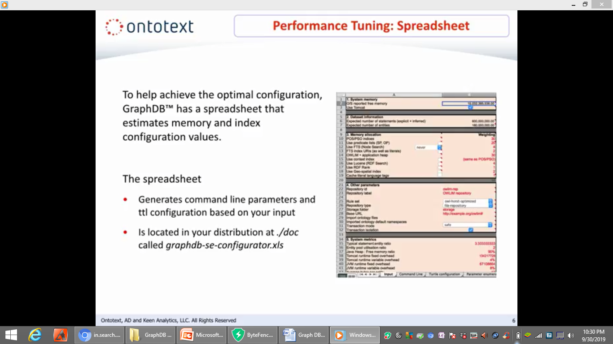
PERFORMANCE TUNING: SPREADSHEET
Notes:
To aid in the creation of the most
optimal configuration graph DB comes
with a tool that estimates memory and
index configuration values this
spreadsheet will generate command line
parameters in TTL configuration based on
your input it is located in your
distribution at dot slash DLC called
graph DB se configurator dot XLS

Slide 14
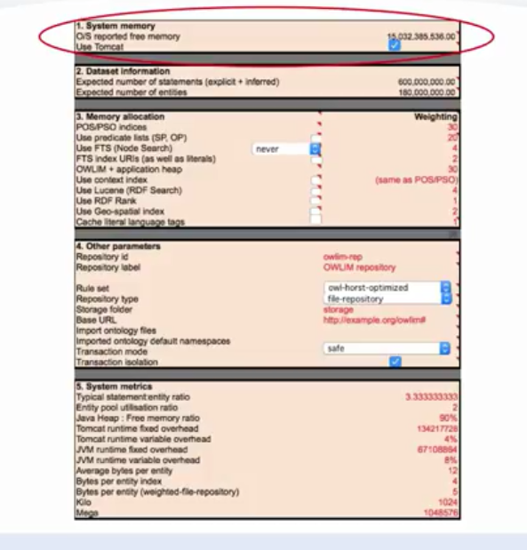
PERFORMANCE TUNING: SYSTEM MEMORY
Notes:
Let's
look at the spreadsheet in a bit more
detail the first section contains system
memory information the data set
information section contains the
expected number of statements and
entities this section is used to set all
the configuration parameters that affect
memory allocation and consumption first
predicate subject object indices cannot
be disabled for the rest these depend on
your actual usage if you are using
wildcard predicate patterns enable
subject predicate object predicate if
you are using full text search turn it
on as an example if you're using name
graphs extensively then you may click on
the box to turn on the context indices
or lose scene or RDF rank or the
geospatial index
[Music]
in the other parameters section you will
want to select a rule set for the
desired semantics the system metrics
section shows such information as the
entity ratio entity pool utilization
ratio Java heap free memory ratio and
Tomcat runtime information

Slide 15
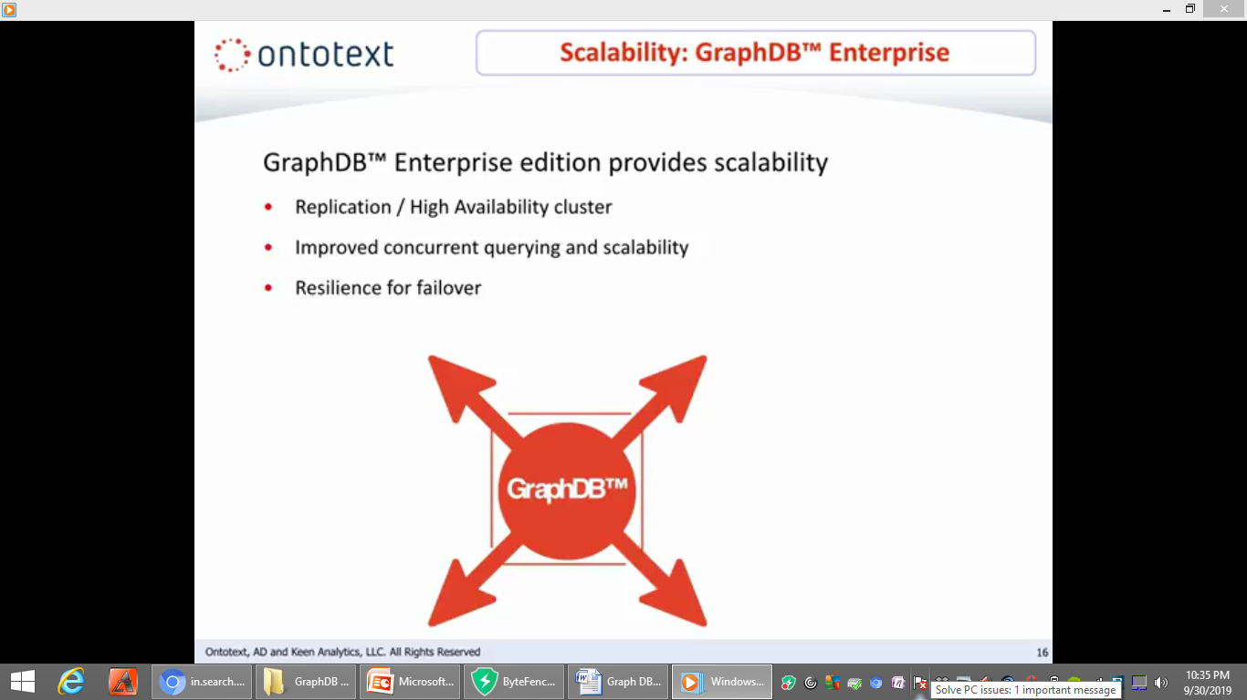
SCALABILITY: GraphDB ENTERPRISE
Notes:
now let's
talk about scalability graph DB uses a
replication cluster to improve
scalability of concurrent query requests
it also provides resilience for failover

Slide 16
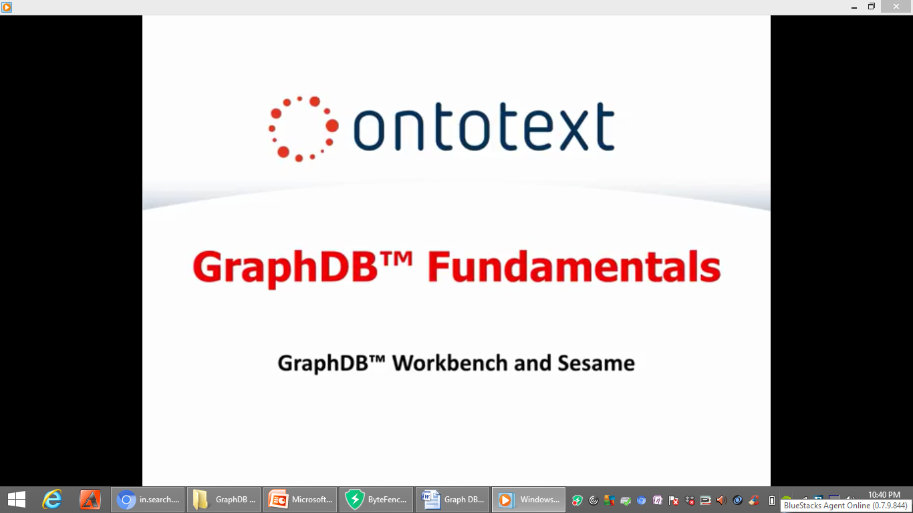

Slide 17
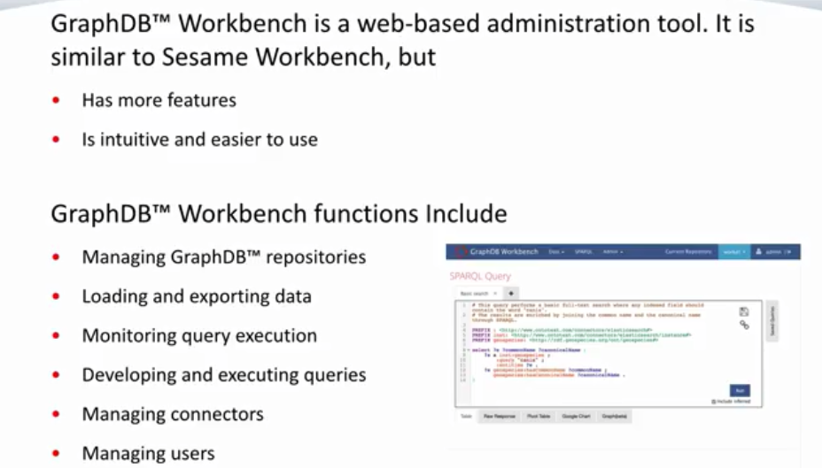
GraphDB WORKBENCH AND SESAME
Notes:
The graph DB workbench is a
web-based administration tool that is
used for administrative tasks the graph
DBU workbench is similar to sesame
workbench but is much easier and
intuitive to use and has a full set of
capabilities for managing configuring
and performance tuning graph DB
repositories you can use graph DB
workbench to manage graph to be
repositories load and export data
monitor query execution with the ability
to terminate executing queries manage
connectors and manage users and
permissions

Slide 18
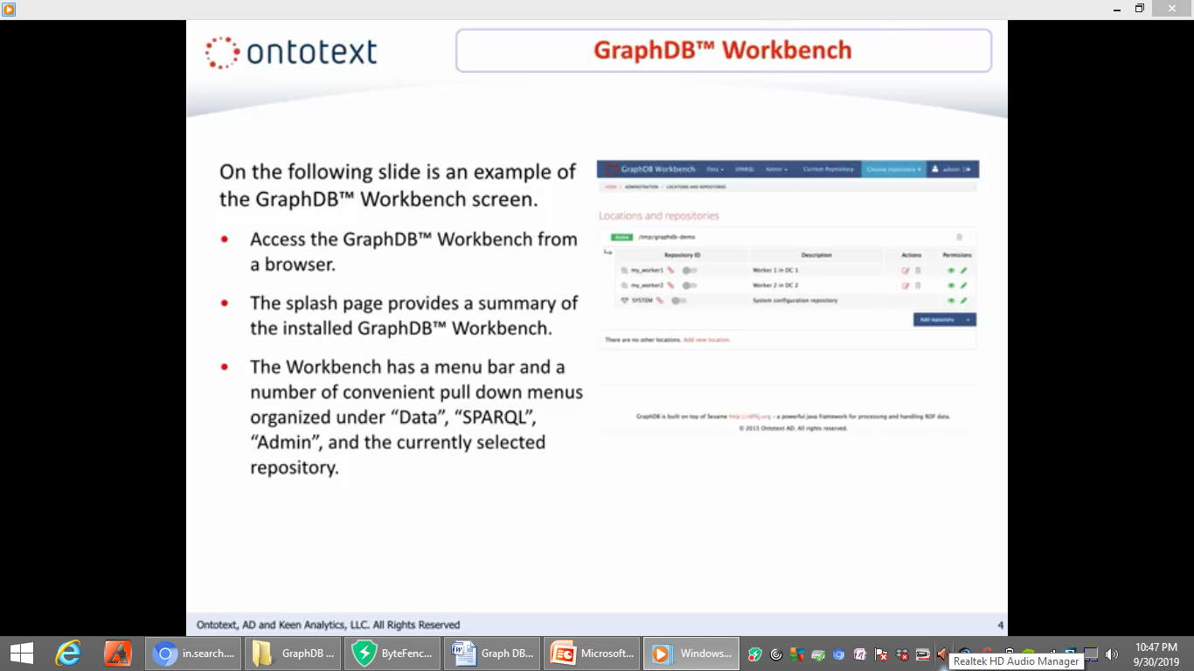
GraphDB WORKBENCH
Notes:
On the following slide is an
example of the graph DB workbench screen
access the graph DB workbench from a
browser the splash page provides a
summary of the installed graph DB
workbench the workbench has a menu bar
and a number of convenient pulldown
menus organized under data sparkle admin
and the currently selected repository
let's take a look on the next slide

Slide 19
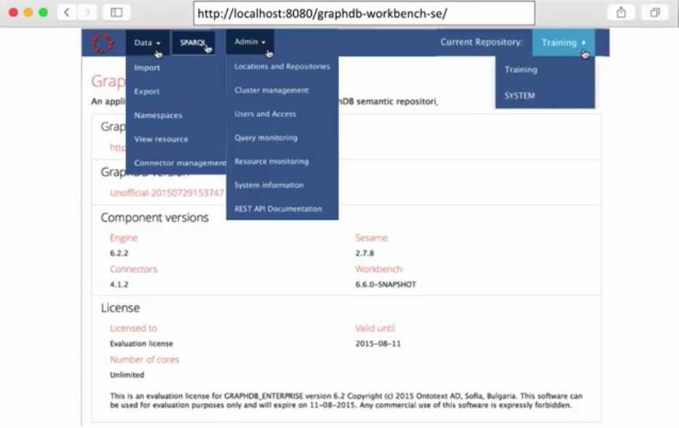
ACCESS GraphDB WORKBENCH
Notes:
The
data menu has options for importing and
exporting data adding new resources and
for managing connectors the sparkle menu
takes you directly to a syntax directed
sparkle query and update editor the
admin menu has options for managing
repositories users namespaces displaying
system information monitoring
resource usage and monitoring queries
the current repository menu item allows
you to pick from a list of repositories

Slide 20
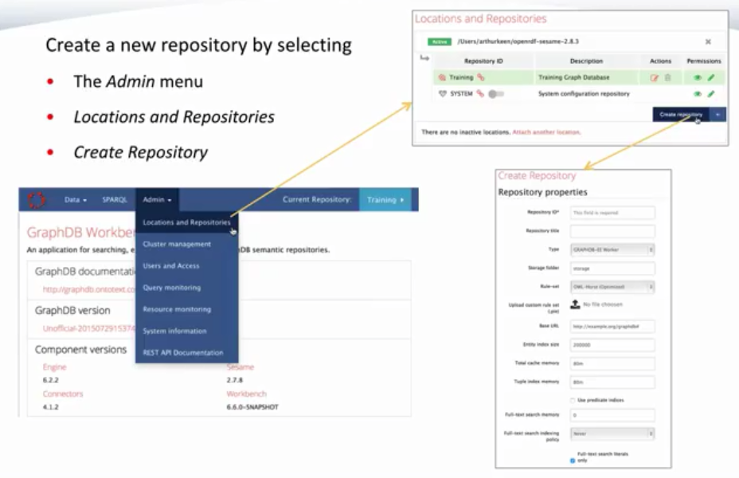
CREATE NEW REPOSITORY
Notes:
now let's look at creating a repository
you can create a new repository by
selecting the admin menu selecting
locations and repositories and then
selecting create repository

Slide 21
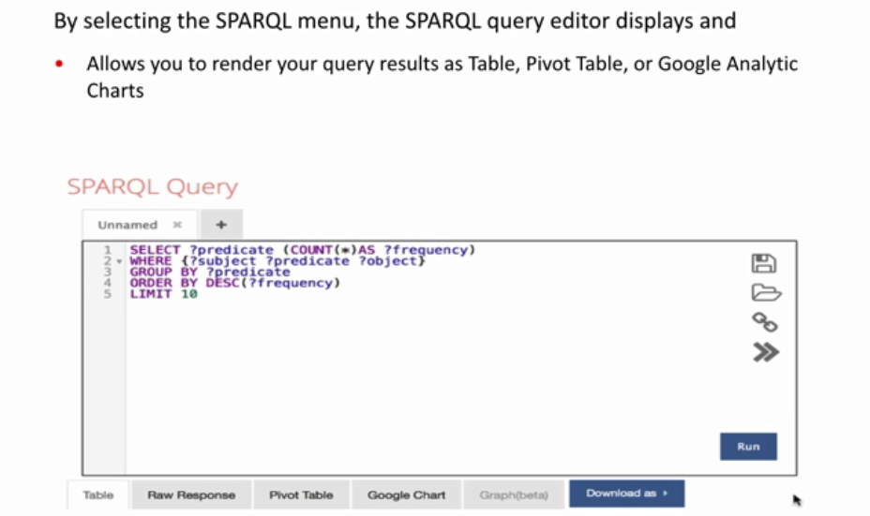
EXECUTIVE QUERIES WITH GraphbDB WORKBENCH
Notes:
now let's
look at executing queries with graph DB
workbench selecting the sparkle menu
takes you to the syntax directed Sparkle
query editor that allows you to render
your query results as table pivot table
or Google analytic charts

Slide 22
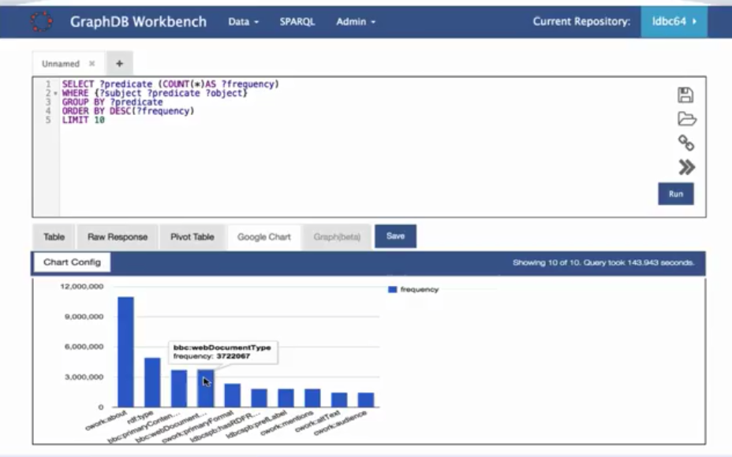
GraphDB WORKBENCH QUERY EDITOR
Notes:
let's look at
the graph DB workbench query editor
enter your sparkle query using the query
editor your graph will be displayed in
the bottom portion of the screen looking

Slide 23
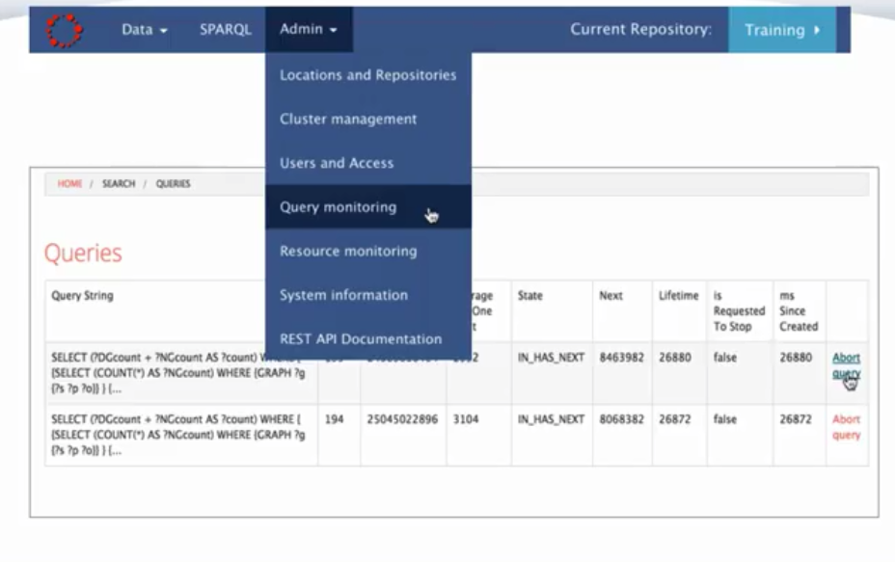
QUERY MONITORING: ABORT QUERY
Notes:
At another important feature graph DB
allows you to abort long queries that
are executing for example you may have
created a query that is long-running and
you would like to halt it and perhaps
modify it and resubmit it not wanting to
wait until it completes let's say you
have submitted a long-running query in
the editor that counts triples in all of
the graphs and you decide you want to
halt the query simply go to the admin
menu select query monitoring and abort
the query

Slide 24
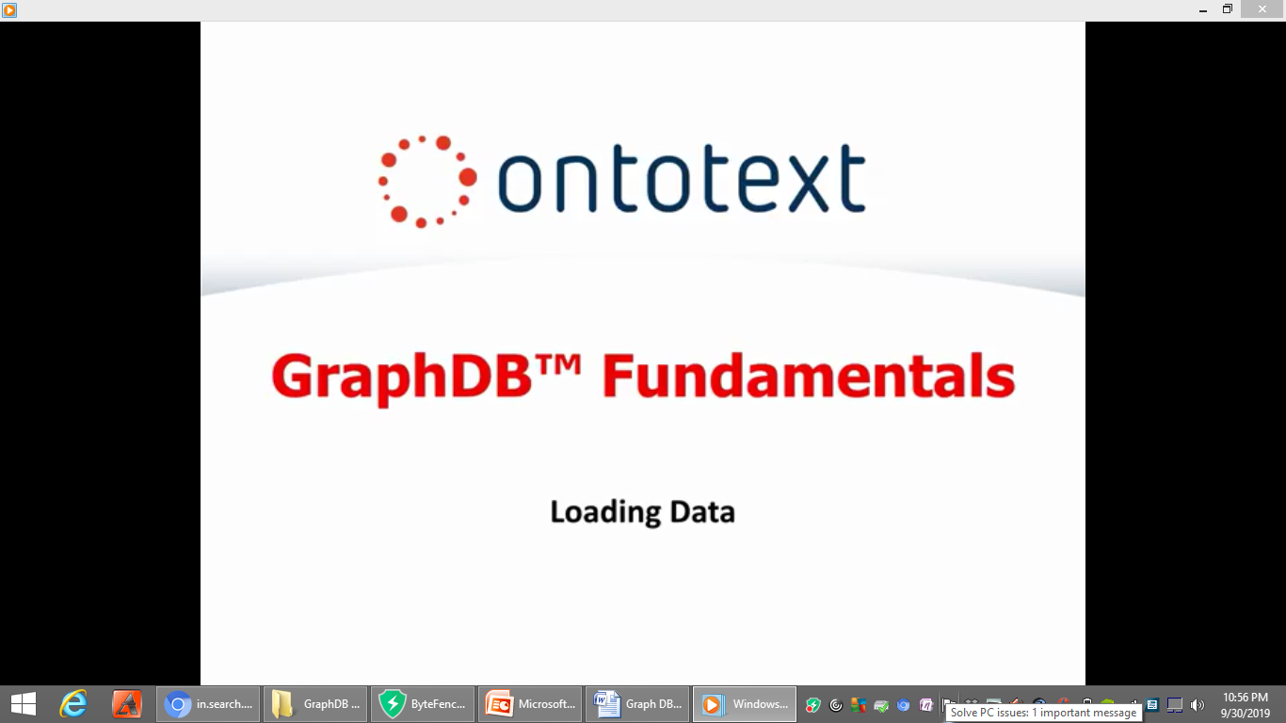
Notes:
loading data

Slide 25
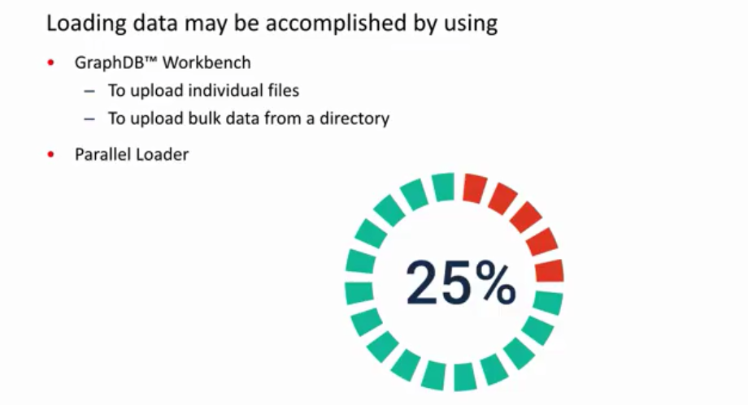
LOADING DATA
Notes:
Let's get started loading
data may be accomplished by using the
graph DB workbench or parallel loader
you can use graph DB workbench to upload
individual files or to upload bulk data
from a directory

Slide 26
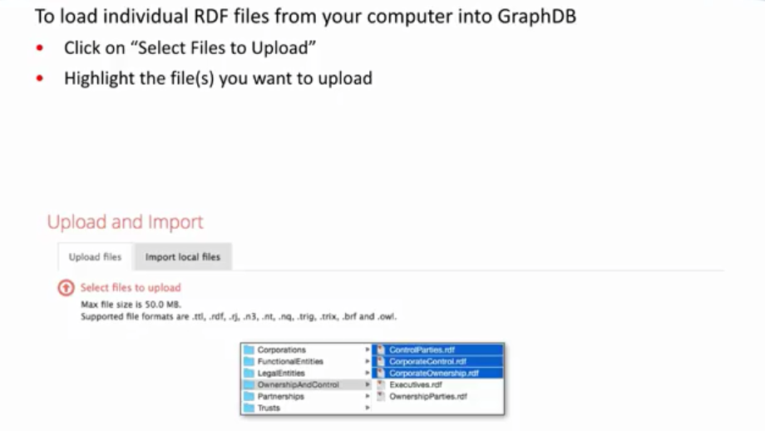
LOADING INDIVIDUAL FILES
Notes:
To upload individual
files using the graph DB workbench click
on select files to upload highlight the
file or files you want to upload

Slide 27
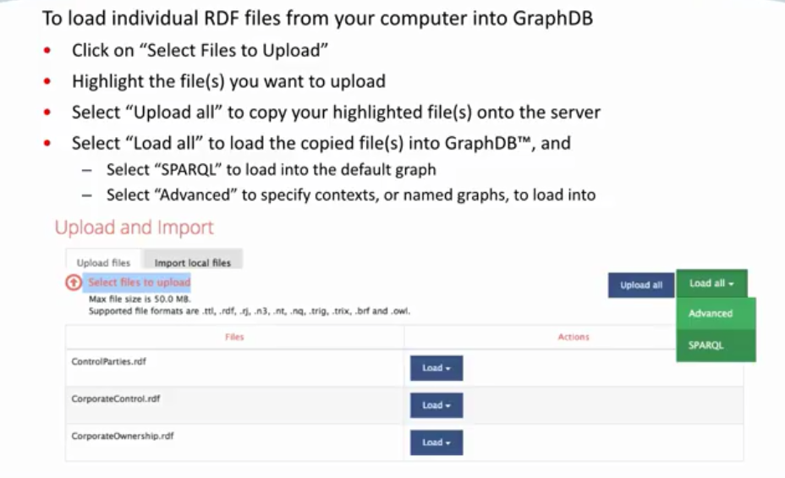
LOADING INDIVIDUAL FILES
Notes:
then
select upload all to load the file or
files onto the server now that the files
are on the server you want to upload
them into graph dB
select load all to load the file or
files into graph DB next either choose
sparkle for a default graph or choose
advanced to specify named graphs

Slide 28
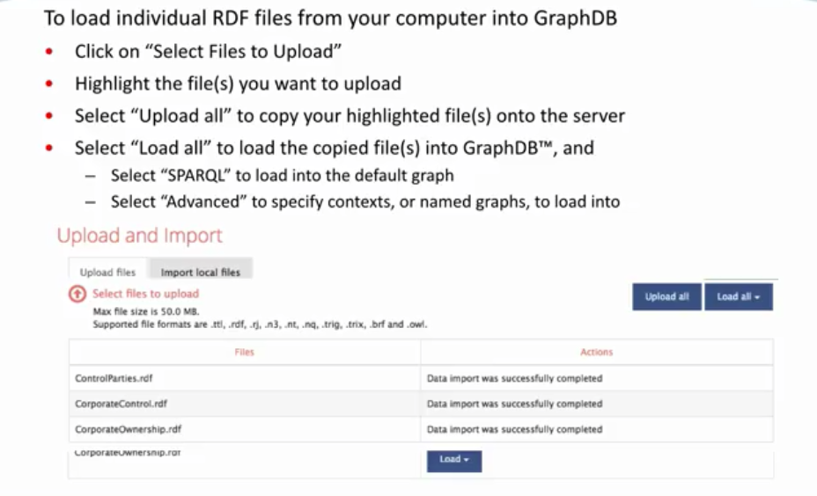
LOADING INDIVIDUAL FILES
Notes:
after
you have finished your upload you will
see the message data import was
successfully completed for the file or
files that you loaded

Slide 29
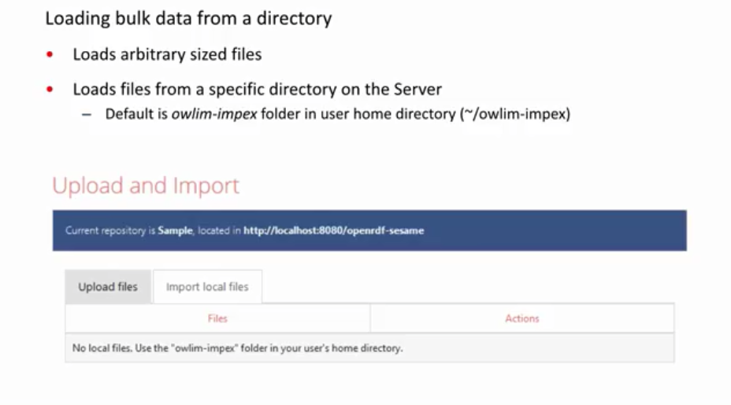
LOAD BULK DATA FROM A DIRECTORY
Notes:
now let's look at
loading bulk data uploading bulk data
from a directory allows you to load
arbitrary sized files and places the
files in a specific directory the
default folder is a LEM - impacts in the
user home directory

Slide 30
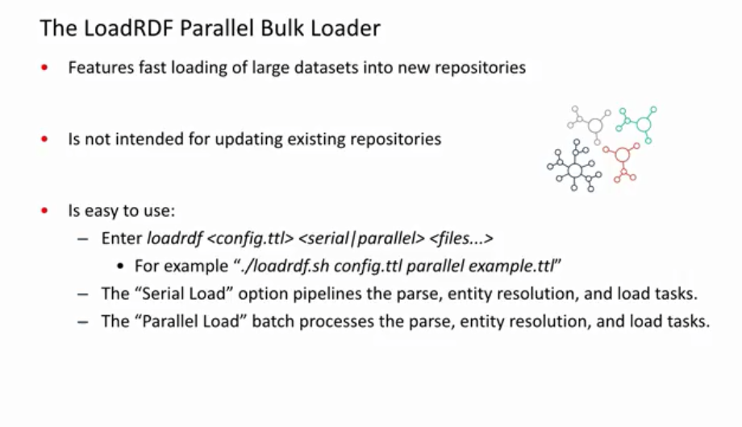
LoadRDF PARALLEL BULK LOADER
Notes:
the load rdf
parallel bulk loader features fast
loading of large data sets into new
repositories the bulk loader is not
intended
for updating existing repositories it's
easy to use simply enter load rdf the
name of the config file serial or
parallel option and the file names the
serial load pipelines the parse entity
resolution and load task and the
parallel load batch processes the parsed
entity resolution and load task

Slide 31
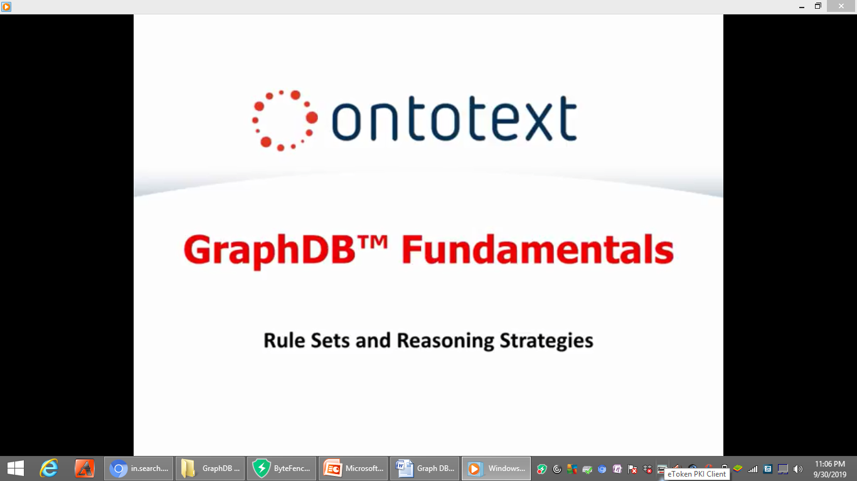

Slide 32
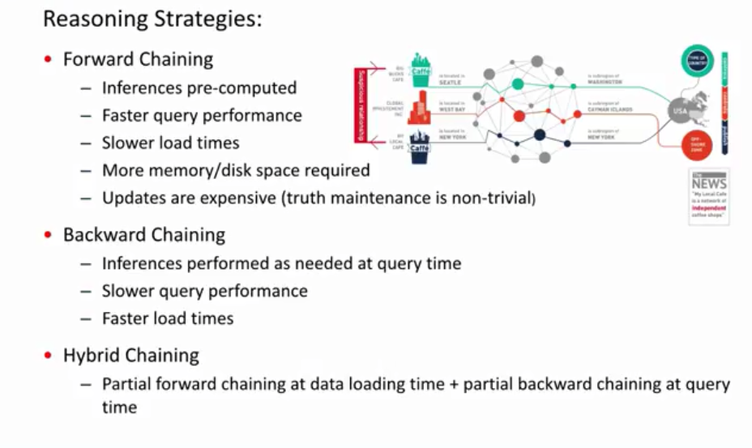
REASONING STRATEGIES
Notes:
Let's
get started first we'll look at
reasoning strategies three reasoning
strategies are forward chaining backward
chaining and hybrid chaining with
forward chaining inferences are pre
computed you have faster query
performance but slower load times and
use more memory or disk space and
updates are expensive with regard to
backward chaining inferences are
performed as needed at query time you
have slower query performance but faster
load times the third reasoning strategy
hybrid chaining uses both forward and
backward chaining that is partial
forward chaining at data loading time
and partial backward chaining at query
time

Slide 33
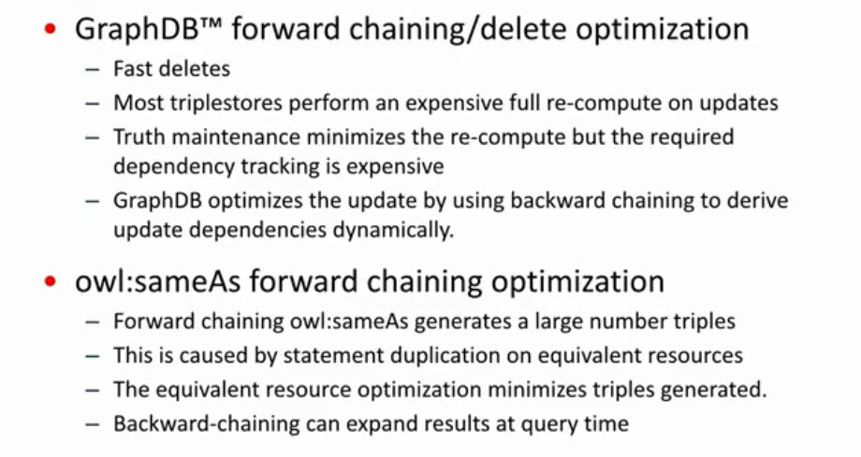
GraphDB REASONING OPTIMIZATION
Notes:
Now let's look at reasoning
optimizations delete optimization and
forward chaining optimization first most
triple stores perform an expensive full
recompute on updates truth' maintenance
minimizes the recompute but the required
dependency tracking is expensive in
response graph DB optimizes the update
by using backward chaining to derive
update dependencies dynamically
resulting in fast deletes second forage
chaining else same as generates a large
number of triples this large number is
caused by statement duplication on
equivalent resources in response graph D
B's equivalent resource optimization
minimizes triples generated backward
chaining can expand results at query
time

Slide 34
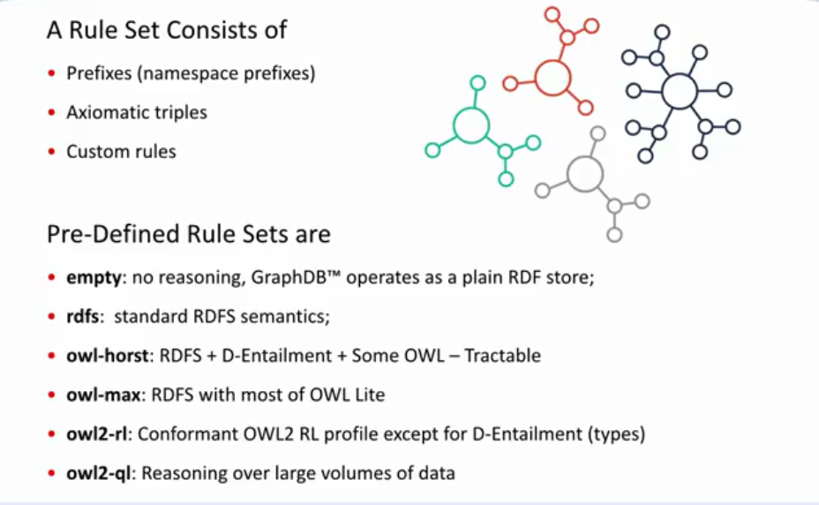
RULE SETS
Notes:
Finally let's look at rule sets a rule
set consists of prefixes that is
namespace prefixes axiomatic triples and
custom rules the predefined rule sets
are empty which represents no reasoning
graph DB operates as the plain RDF store
RDFS which is standard RDFS semantics al
Horst which is the RDF S Plus D
entailment plus some L which is
tractable L max which is RDFS with most
of L light a URL which is conformant out
to our L profile except for D entailment
and al to QL which is reasoning over
large volumes of data.

Slide 35
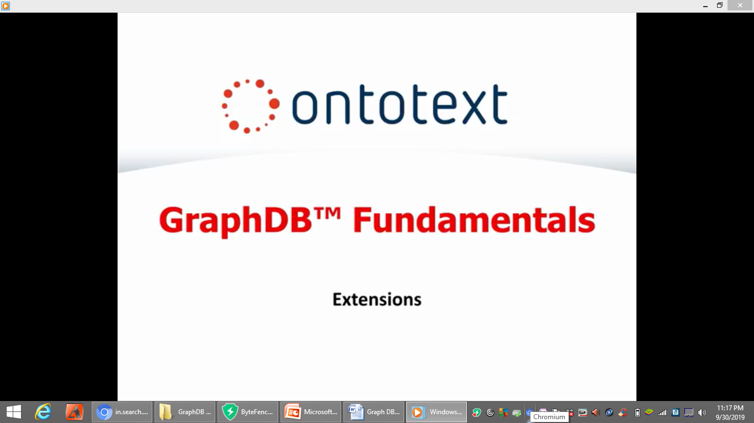

Slide 36
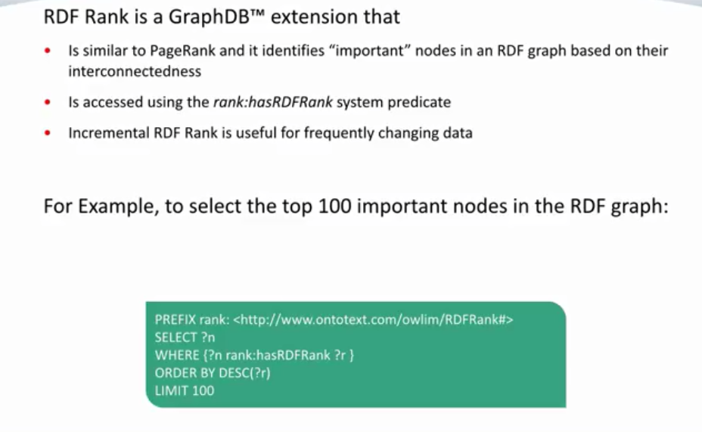
RDF RANK
Notes:
Let's get started the first
extension we will look at is the rdf
rank the rdf rank is a graph DB
extension that is similar to page rank
and it identifies important nodes in an
rdf graph based on the
interconnectedness and is accessed using
the rank has rdf rank system predicates
incremental rdf rank is useful for
frequently changing data for example to
select the top 100 important nodes in
the rdf graph you can create a query as
shown below using prefix select where
order by and limits statements

Slide 37
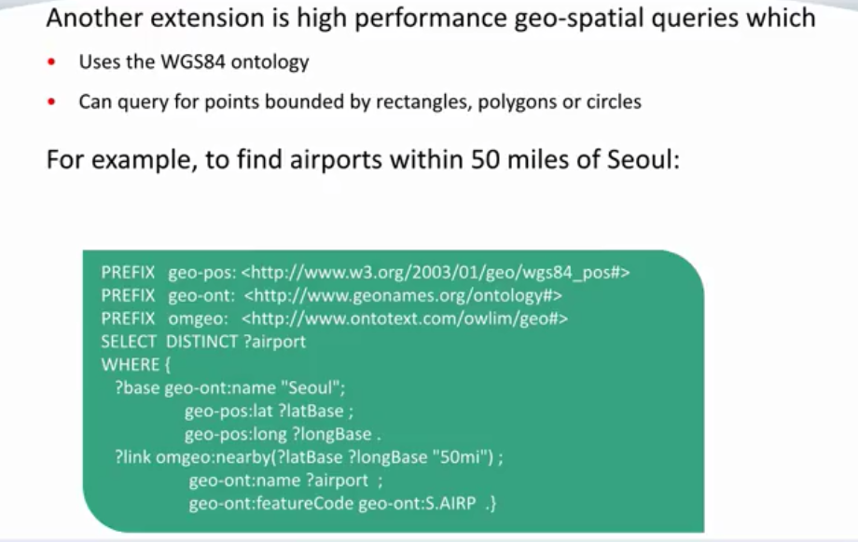
GEO-SPATIAL
Notes:
Another
graph DB extension is the
high-performance geospatial queries
these geospatial queries use the wgs 84
ontology and can query for points
bounded by rectangles polygons or
circles for example to find airports
within 50 miles of soul you can create a
query as shown below using prefix select
and where statements

Slide 38
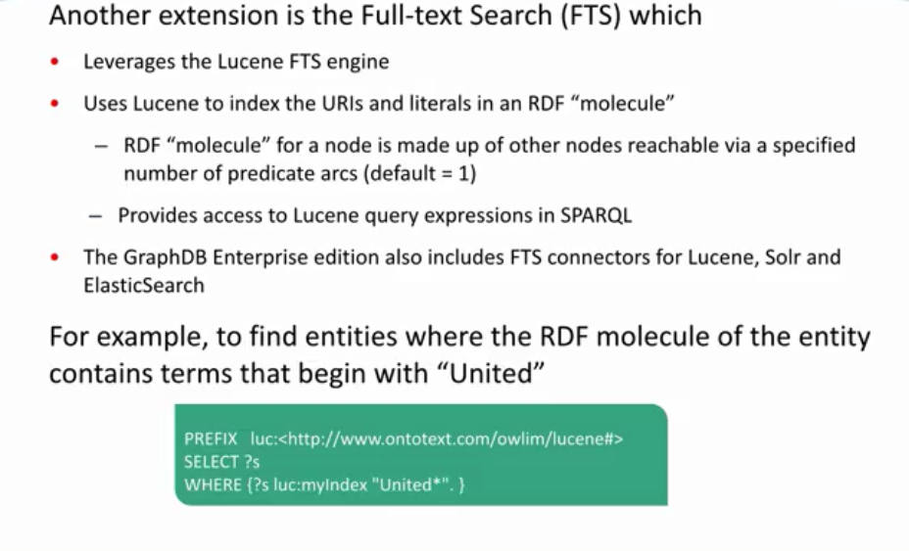
FULL TEXT SEARCH
Notes:
the final graph DB
extension will look at is the full text
search which leverages the leucine fts
engine this extension provides full-text
search over the rdf and uses leucine to
index text in rdf molecules it also
provides access to leucine query
expressions
sparkle the full text search is also in
the graph DB Enterprise Edition which
includes connectors for loosing solar
and elastic search for example to find
entities where the RDF molecule of the
entity contains terms that begin with
United you can create a query as shown
below using prefix select and where
statements

Slide 39
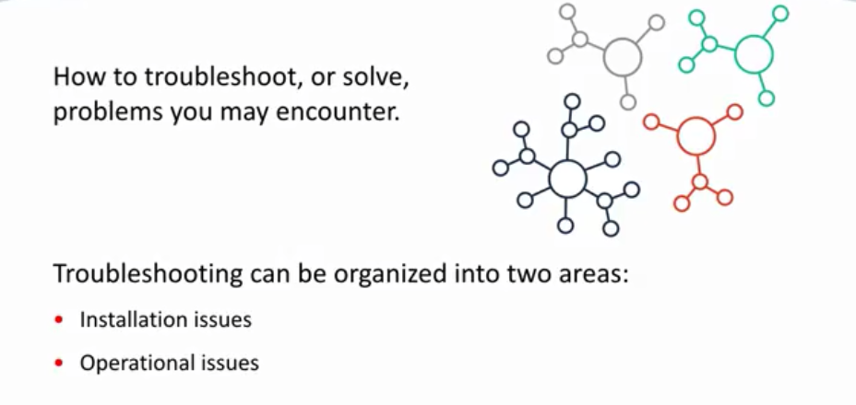
TROUBLESHOOTING

Slide 40
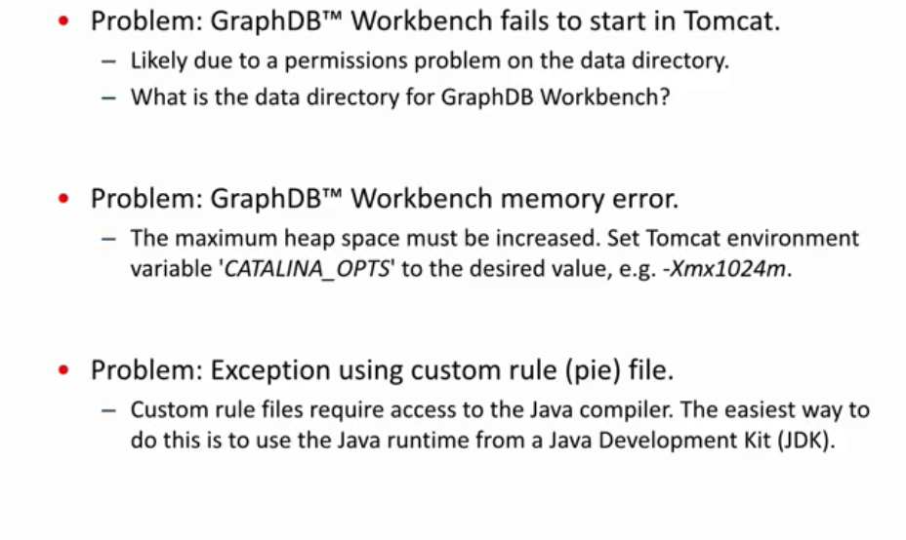
TROUBLESHOOTING INSTALLATION ISSUES
Notes:
Although it is
unlikely that you will encounter any of
these issues let's review them just in
case the first problem may be that graph
DB workbench fails to start in tomcat
this problem is likely due to a
permissions problem on the data
directory check the data directory for
graph DB workbench the second problem
encountered may be a graph DB workbench
memory error to resolve this problem the
maximum heap space must be increased set
Tomcat environment variable catalin offs
to the desired value the third problem
may be encountering an exception using
custom rule file custom rule files
require access to the Java compiler the
easiest way to accomplish this is to use
the Java runtime from a Java development
kit

